Slide 1
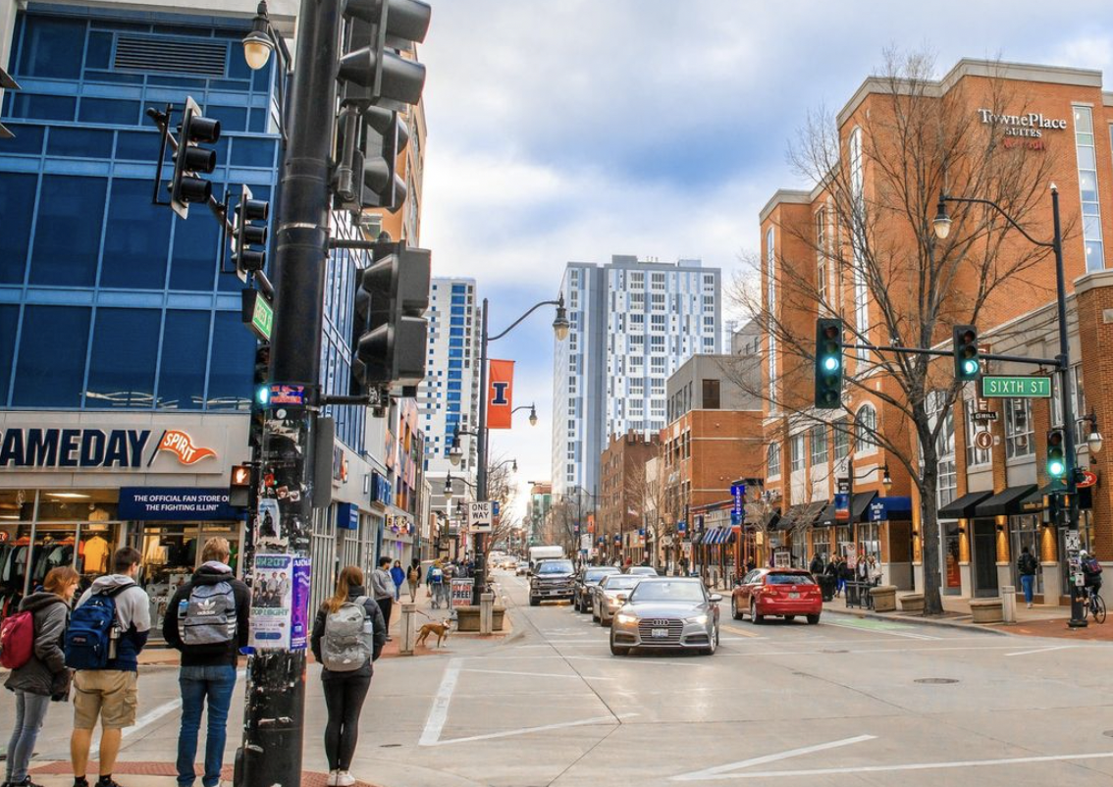
SafeStep Alert System

Slide 2
Who did you observe and where? We observed pedestrians at a busy intersection on green street, Champaign . The focus was on individuals of various demographics, including young people, parents with children, teenagers, and elderly citizens.

Slide 3

What was the person doing? We observed people, engrossed in their smartphone, likely scrolling through social media or texting, while waiting to cross the street. Despite the pedestrian signal indicating "Do Not Walk," they began to step off the curb, distracted by their phone and not paying attention to the traffic signals.

Slide 4
Problems The primary issue was the distraction caused by their smartphone. Engrossed in texting, social media, or other applications, the individual was not fully aware of their environment, particularly the status of the pedestrian signal.. The person might cross this intersection regularly and rely on habit rather than actively checking the pedestrian signals each time, assuming it's safe to cross based on routine rather than the actual signal.

Slide 5
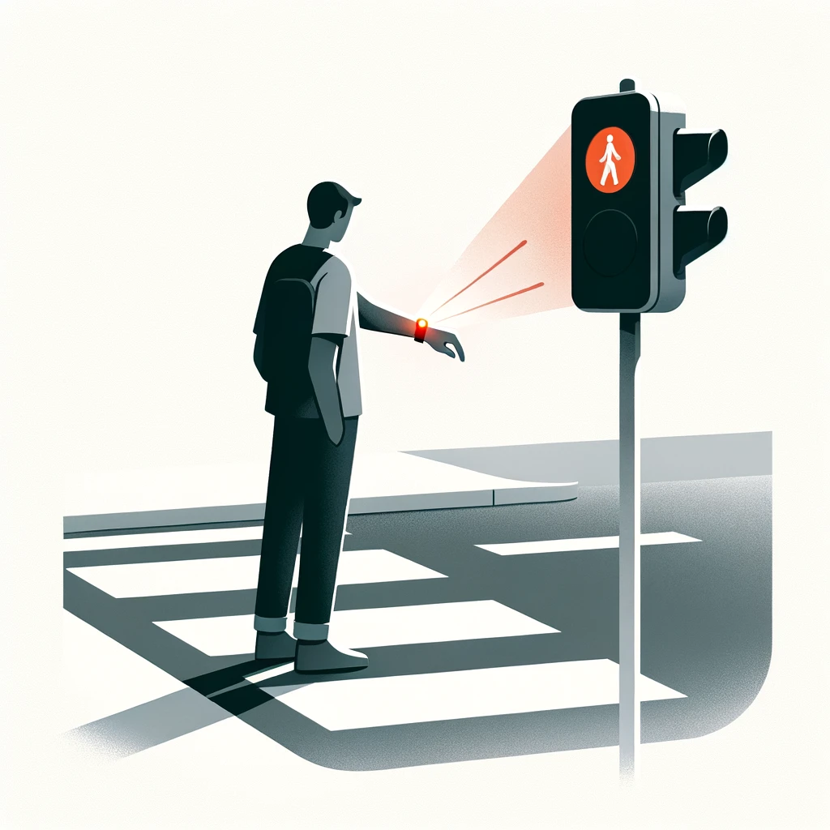
Solution for this… Product Idea: SafeStep Alert System: The SafeStep Alert System is an innovative solution designed to enhance pedestrian safety by providing real-time alerts to individuals attempting to cross the street when the pedestrian signal is red or when it's unsafe to cross. This system integrates smart technology with pedestrian infrastructure to reduce accidents and encourage safer crossing behaviors.

Slide 6
Key Features: Smartphone and Wearable Device Integration: Sends real-time push notifications or alerts to users devices when attempting to cross unsafely. Pedestrian Signal Sensors: Detects the status of pedestrian signals and communicates with the SafeStep network to monitor and respond to pedestrian activity. Geo-Fencing Technology: Establishes a geo-fenced area around crosswalks to identify and alert users within a potential risk zone. Motion Detection: Utilizes motion sensors to detect when a pedestrian is moving towards the curb during a "Do Not Walk" signal. Educational Content: Provides users with tips and statistics on pedestrian safety to encourage safer crossing habits. Community Alerts: Offers opt-in alerts about high-risk intersections or areas known for jaywalking incidents. Data Collection for Urban Improvement: Gathers anonymized data on crossing behaviors to aid in urban planning and pedestrian infrastructure development. Emergency Services Integration: Includes features for quick access to local emergency contacts and safety information.

